Slide 1
Sign-Language Recognition Using Machine Learning
G kiran kumar (318126510139)
M Sumanth (318126510155)
E V M Prateek (318126510138)
Azharuddin (318126510174)
Charan Reddy (317126510106)
Guided By
Dr. V Usha Bala

Slide 2
What is sign language?
Sign language is a way of communicating using hand gestures and movements, body language and facial expressions, instead of spoken words.
There are different sign languages
  Indian sign language
  American sign language
  British sign language
The sign language we are Recognising is INDIAN Sign Language

Slide 3

Problem Statement
To Identify the signs and gestures in Indian sign language and convert them into English.
?
?
?

Slide 4
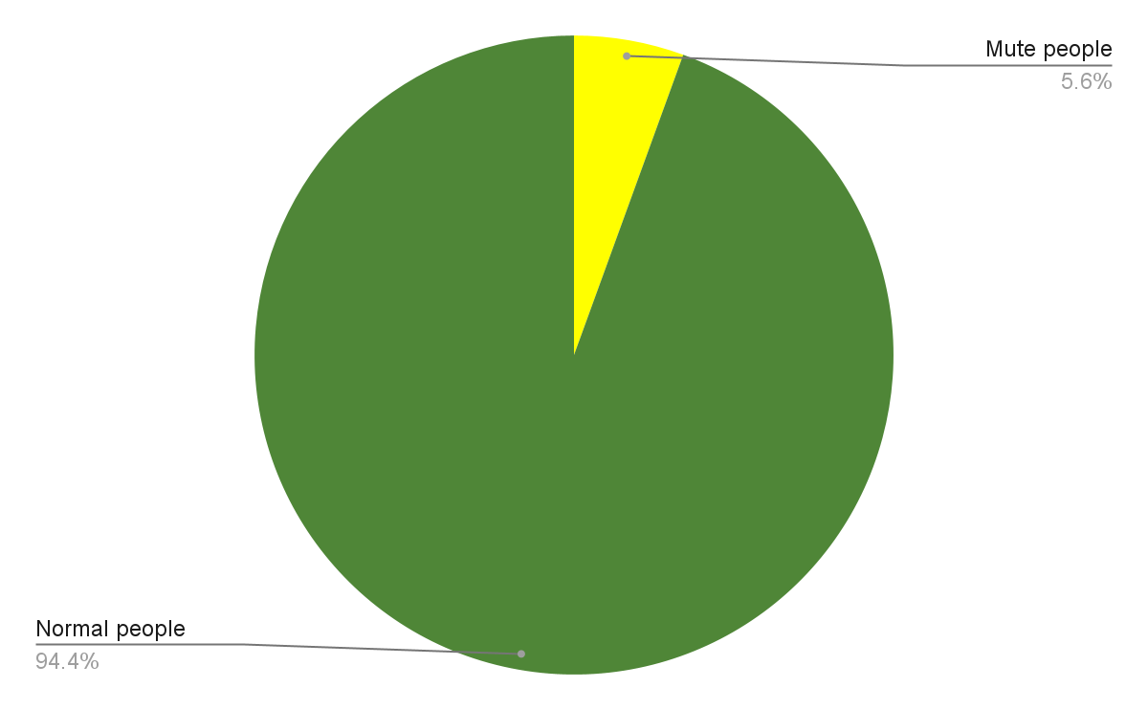



Scope of project
Translator
Sign language
Verbal Communication

Slide 5
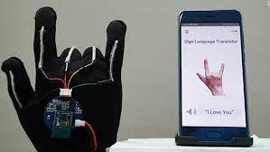
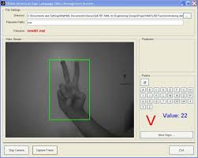
Existing System
There are a few sign language translation systems
  Sensor Gloves
    Accurate
    Easy to use
    Costly
  Algorithms to recognise signs
    Cost effective
    Uses color gloves sometimes to increase
    Accuracy
    Less accuracy for multi handed signs

Slide 6

Proposed System
We propose to use Machine learning algorithms to recognise the
Gestures and signs in Indian sign language.
We train the Machine learning model with videos containing signs and gestures in indian sign language.
We will send the words identified to a sentence generator algorithm to make a proper english sentence with the generated words.
Finally the generated output will be shown on screen and played out-loud using the device speaker.

Slide 7

Abstract
While there is no problem among them to communicate smoothly using this language the problem comes when they try to communicate with people who do not know sign language. We suggest a solution to this problem using ML based translator that can identify Indian sign language and translate to English.

Slide 8
Objectives
To decide on the classes of gestures we want to identify.
To train different models to identify signs and gestures in Indian sign language and identify the one with highest accuracy.
Fit a model using Natural Language Processing to generate proper sentences using generated words.
  Eg: Sign Language - I, Kiran → I Kiran → NLP → I am Kiran.

Slide 9
Architecture
Step 1: To extract the frames from the video captured.
Step 2: Identify the gestures in the video.
Step 3: Send the generated words to Sentence generator.
Step 4: Generate a proper English sentence.
Step 5: Display the sentence Tell the sentence out loud using device audio

Slide 10
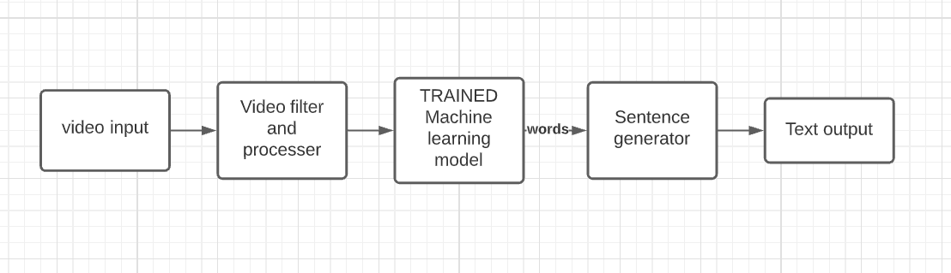

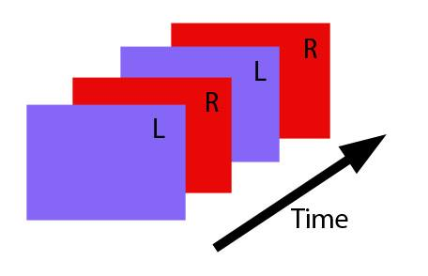
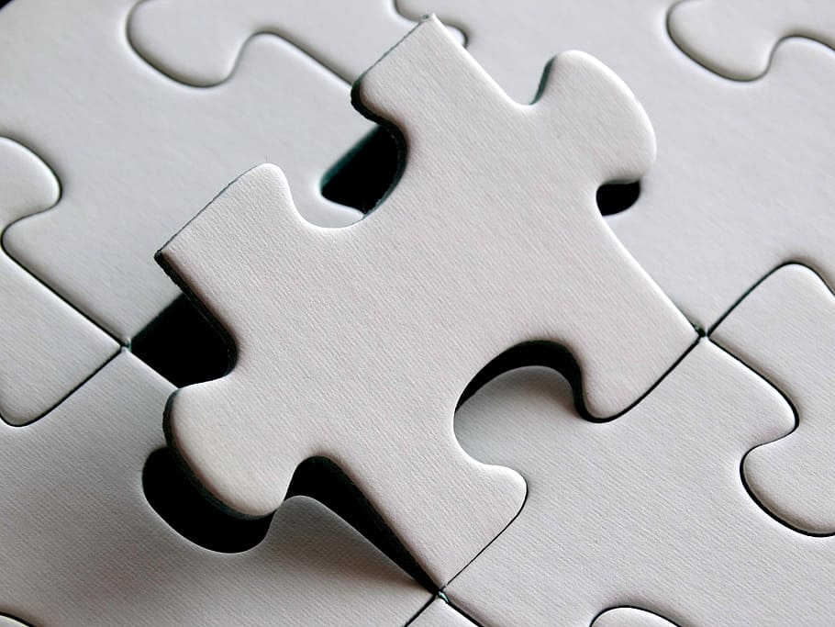
Architecture diagram
I am Kiran

Slide 11
References
Research Papers
https://www.sciencedirect.com/science/article/pii/S1877050917320720
https://www.sciencedirect.com/science/article/pii/S1877050918321331
https://drive.google.com/file/d/1shxPAgjxEXbfGDJJPJCvVoPRw_ulz-9E/view?usp=sharing
Official Sign translation and dictionary
https://indiansignlanguage.org/
http://www.islrtc.nic.in/

Slide 12

Thank you for your time.

